Slide 2
Micah Liverpool is a social justice charity set up jointly by Liverpool Cathedral, Liverpool Metropolitan Cathedral of Christ the King and St Bride’s Church to relieve Liverpool residents from social injustice and poverty.
Micah currently focuses on three areas of work to combat unemployment; deliver emergency food aid and develop affordable food places.

Slide 3
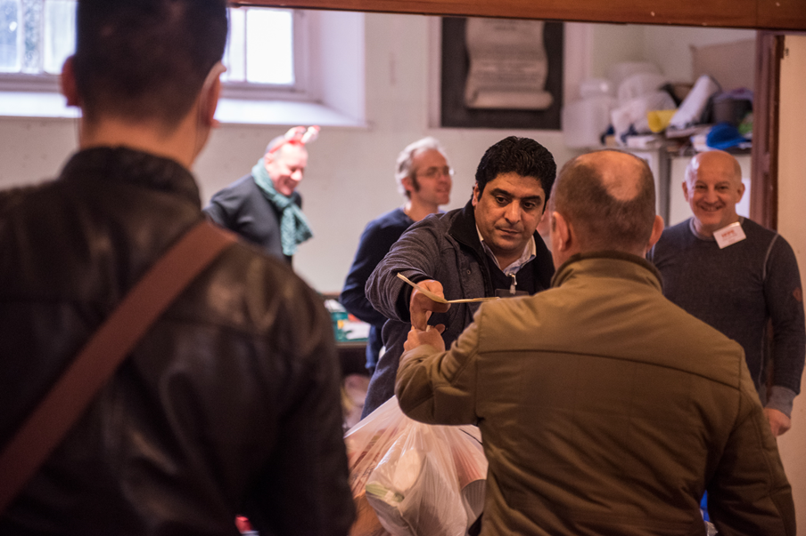
Micah Liverpool
Liverpool a dispersal point for Asylum Seekers
Numbers high – diverse cultures and personal and travel stories
Many Languages – including Spanish, French, Farci, Portuguese, Arabic, Romanian,
Accommodation – hostels, hotels
Food and culture – halal, vegan
Pregnancy – ante and post natal
Lone(ly) Parents -
Mental Health and well being
Traumatisation – stories: listening
Positive welcome

Slide 4
What Micah provide:
Our food bank sessions are open to anybody in need: we provide an emergency 3 day food parcel once a week, and a bag of fresh produce for four weeks over a 3 month period. If after this period further support is needed, evidence shall be required.
Micah Liverpool operates two food banks a week where we provide 3 days of Emergency Food Aid for each guest. We have been able to support approximately 8000 guests in the last 6 months, including over 1,400 children. We have provided an average of 220/450 food parcels each week: we provided over 12,500 food parcels in 2019.
This winter we were able to provide a winter boost package including high quality fruit and vegetables, eggs and tinned fish.

Slide 5
Working in Partnership
Refugee women connect
Asylum Link
Red Cross
Migrant Health
Feeding Liverpool
Diocese of Liverpool
Archdiocese of Liverpool
Together Liverpool - churches
Independent Food Aid Network
Love your Neighbour network

Slide 6
Micah Mothers quote… from Feeding Liverpool research Dec 2021
….Joking with one of the volunteers who passes by as we speak, Sikarthmi explains that Micah Liverpool has begun to “feel like family”. It is more than the food she has received today, it is a place where she feels loved and accepted, giving her the strength to face the road ahead.

