Slide 1
Growing Health:
The health and wellbeing benefits of community food growing
How the health service can use food growing to deliver health outcomes

Slide 2
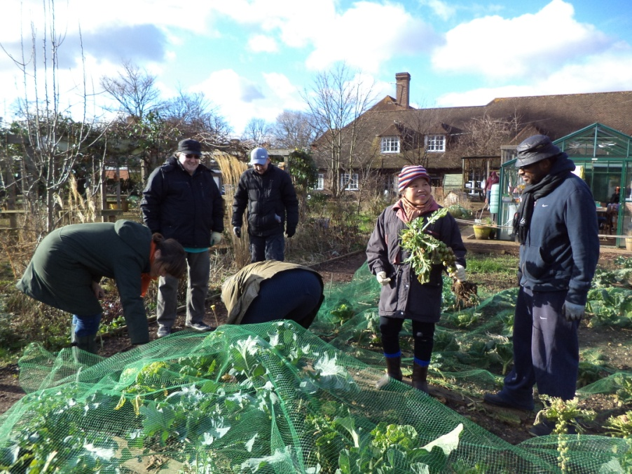
Why support food growing activities?
Positive impact on people’s health and wellbeing
Growing body of evidence supporting the benefits
Can improve mental wellbeing
Help improve physical health
Benefits a wide range of abilities and ages

Slide 3
The benefits
Improve mental health and psychological health including reducing stress, the severity of stress and associated depression.
Increase physical activity, burn calories and contribute to maintaining a healthy weight and reduce the risk of obesity.
Help with rehabilitation or recovery from surgery or other medical interventions.
Alleviate the symptoms of illnesses like dementia and Alzheimer’s disease, such as agitation and aggressive behaviour.
Contribute to improved social interactions and community cohesion.
Provide access to locally grown, fresh produce and help increase the consumption of fruit and vegetables, as well as improving attitudes to healthy eating.
Introduce a way of life to help people improve their wellbeing in the longer term.

Slide 4
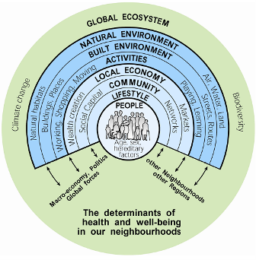
The public health benefits of community food growing
There are many social, economic and environmental factors that impact on health.
Community food growing projects can have positive benefits on these.
Barton, H. and Grant, M. (2006)

Slide 5
Food growing and the determinants of health
Individual lifestyle: supports a healthy lifestyle with regular outdoor activity and contact with nature which helps improve physical and mental health. Provides access to healthy, affordable, locally grown food.
Social and community: engages the community and enhances mechanisms for getting people involved in things that matter to them.
Activities: promotes health and wellbeing as well as an opportunity for learning new skills.
Built environment: physical exercise is designed into the local area.
Natural environmental factors: enhances the natural environment and engages people with nature.
Barton, H. and Grant, M. (2006)

Slide 6
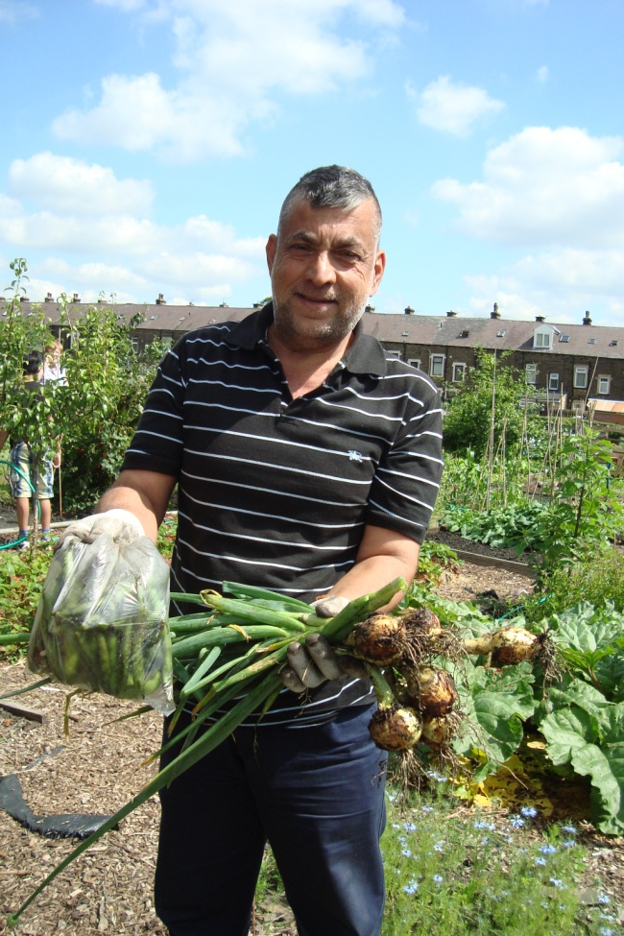
Case study: Public health commissioned project
Gardening for Health (G4H), Bradford
Commissioned by Public Health (part of Bradford Metropolitan District Council).
Aims to reduce health inequalities by encouraging food growing and healthy eating particularly among residents from high risk or ‘hard to reach’ groups.
x16 regular groups in all kinds of locations and participants can self refer.
Particular groups are targeted directly, eg school children, refugees/asylum seekers, patients in mental health units.
.

Slide 7
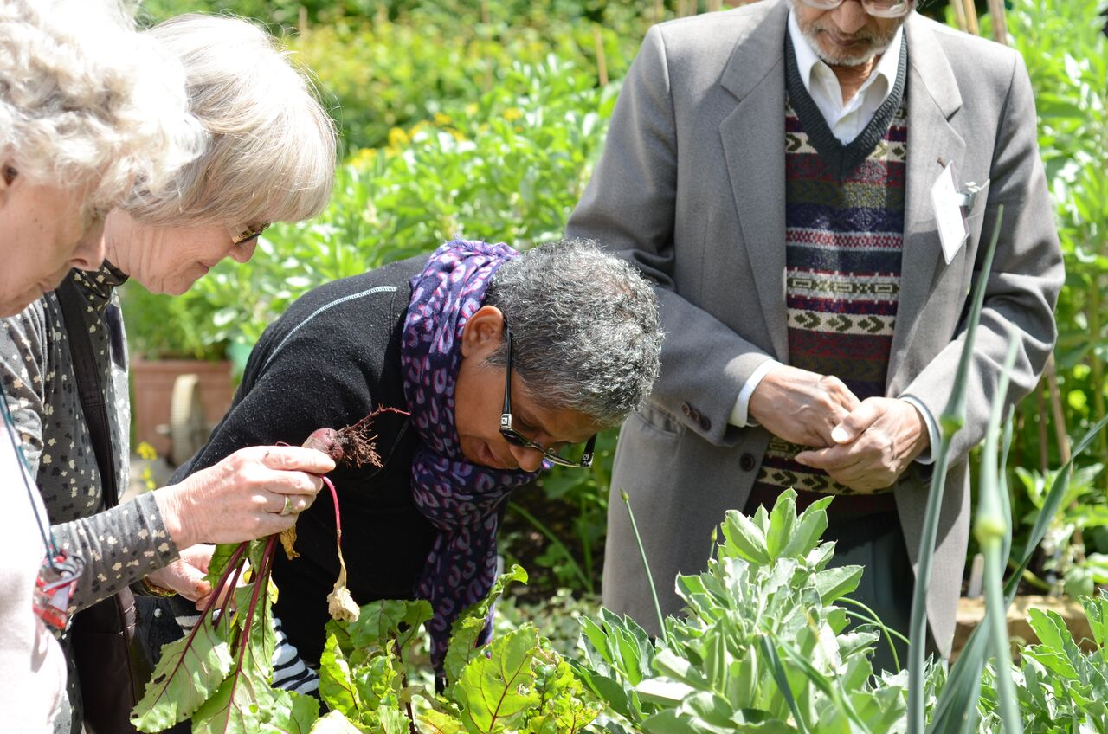
Case study: NHS commissioned service
Sydenham Garden, London
Commissioned by Lewisham Clinical Commissioning Group
Provide garden sessions for adults experiencing mental ill health and people with early stage dementia.
An established health professional referral network.
Services fit with local need and the Joint Strategic Needs Assessment as the prevalence of mental illness is higher in Lewisham compared to the rest of England and most of London.
Poor mental health has a great social and economic impact as well as leading to range of negative health outcomes.

Slide 8
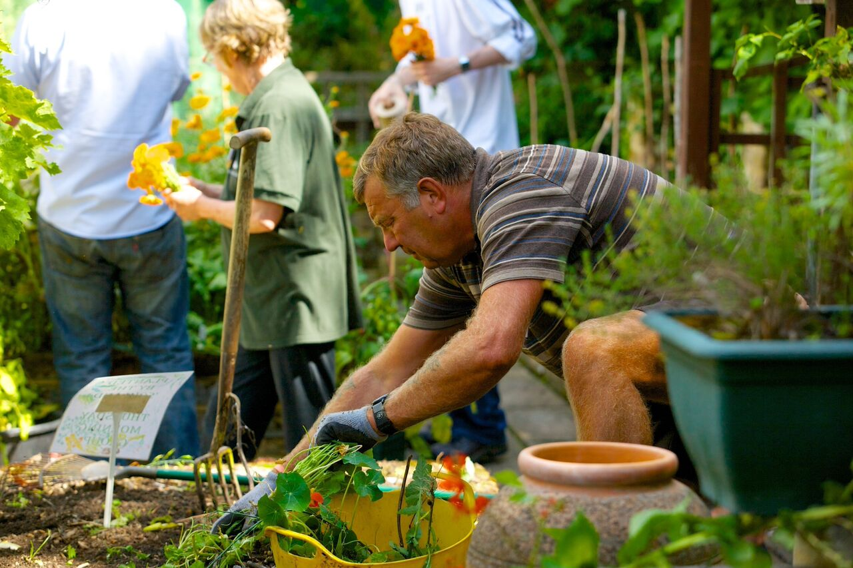
How the health service can work with food growing projects?
Investing and supporting this work results in an effective way to improve health as well as prevent ill health.
Examples of how this has worked include:
Commissioning community food growing projects to deliver health outcomes.
Supporting the setting up or development of projects, including funding.
Providing access to land and other resources such as staff support.
Encouraging and putting in place referral systems e.g. social prescribing.
Training on using food growing for health professionals as part of NHS staff skills and continuing professional development.

Slide 9
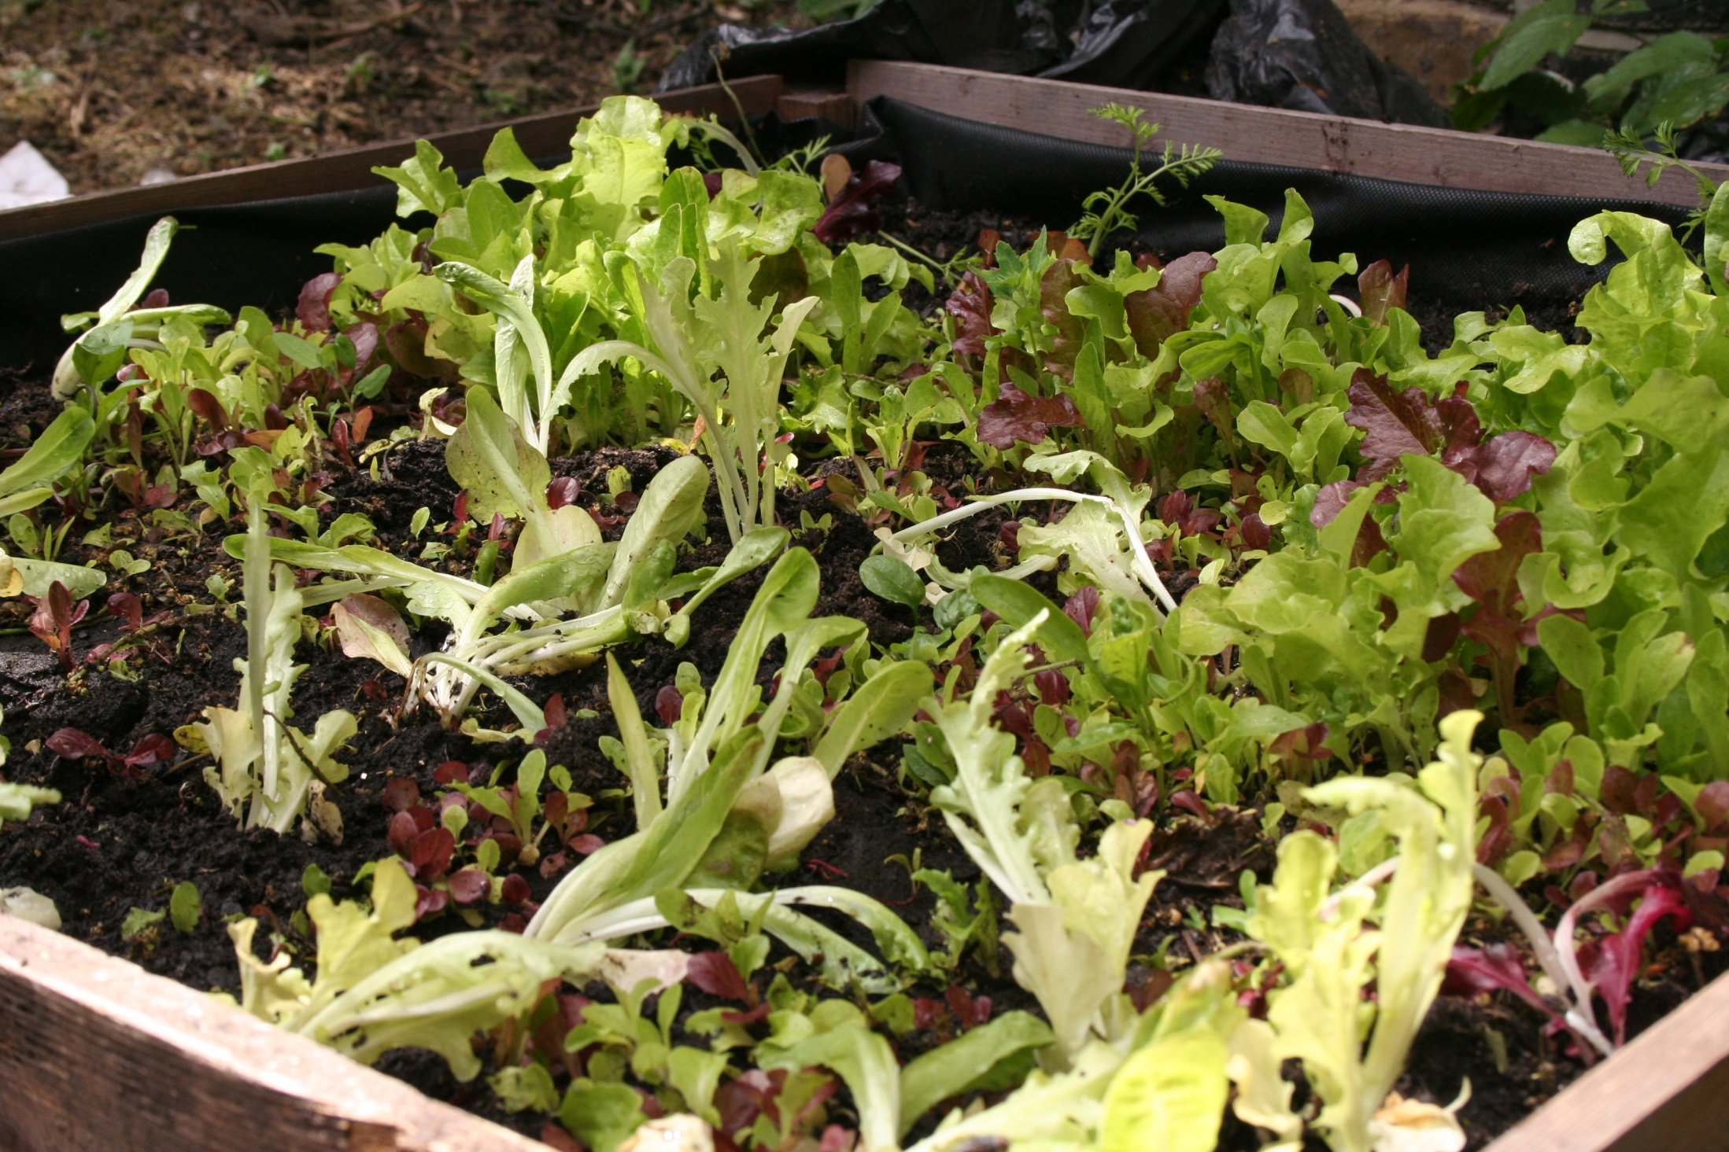
Need more info?
Visit www.growinghealth.info

