Slide 1
Locked into Poverty: Asylum Support Rates
Emma Birks, Campaigns Manager West Midlands
Asylum Matters

Slide 2
What is asylum support?
People seeking asylum are not allowed to work except in exceptional circumstances, and aren’t able to access mainstream benefits.
This means people must access Home Office asylum support while they wait for a decision on their claim.
There are currently more than 60,000 people living on asylum support in the UK.
There are two types Section 95 and Section 4
Notes:
Asylum seekers are supported in a separate |Home Office run system, they are not housed by local authorities and are not eligible for mainstream benefits. Housing is provided by private companies - Serco, Clearsprindgs and Mears
60,000 figure is from year ending Dec 2020 https://www.refugeecouncil.org.uk/latest/news/asylum-applications-fall-in-2020-as-the-backlog-of-cases-awaiting-a-decision-reaches-a-new-high/
Section 95 is given to people waiting for a decision on their asylum claim, this support is continued for families when they are refused. However, support is stopped after adults receive a refusal on their asylum claim and are left destitute.
Refused asylum seekers can apply for Section 4 but this is only provided under certain criteria and is a non cash support.
Both support types are provided on a prepaid card however those on Section 4 can not withdraw funds at a cash machine.

Slide 3
What does asylum support consist of?
Asylum support generally consists of a weekly payment and no-choice accommodation in ‘dispersal’ areas across the UK.
The financial support is currently at a flat rate of £39.63 per person, per week.
While accommodation and utilities are provided for, people have only £5.66 a day to cover their essential living needs.
The rates are set by the Home Office using a ‘pick and mix’ methodology of ONS data and market research
Notes:
This was increased in June 2020 from £37.75 to £39.60; and raised by a further 3p a week in October 2020 after months of assessment by the Home Office.
Essential living needs includes all food and drink, clothing, toiletries, household cleaning items, and everyday medication. It is designed to provide a small amount for travel and communication (1 bus journey a week).
Most recent published report using methodology https://assets.publishing.service.gov.uk/government/uploads/system/uploads/attachment_data/file/673545/Report_on_review_of_cash_allowance_paid_to_asylum_seekers_-_2017_-_final.._.pdf

Slide 4
The struggle to access food
Affording food is very difficult!
People sometimes have to travel long distances
Mothers and children often live in shared accommodation with very limited storage space
Many mothers struggle to buy nappies and formula milk for their babies.
People are living on asylum support for months and even years. At the end of December 2020, 72% of people had been waiting for a decision on their claim for more than six months.
Notes:
Even before the pandemic, it was clear that the low level of asylum support meant that people routinely struggled to access food.
Sometimes people are housed in accommodation long distances from town centres, meaning they have to travel considerable distances to access affordable shops
There is often minimal fridge and freezer space in shared mother and baby accommodation, making it difficult to bulk buy
Even though there is an extra £5 per week for babies under the age of 1 and £3 for those aged 1-3 years, mums often struggle to afford formula
This means people are living for long periods – sometimes years – on incredibly low levels of support, with an incredibly negative impact on psychological well-being and physical health

Slide 5
John told us he has lost 10 kilos in the last two years. Both he and his wife are suffering with depression and she is taking sleeping pills. He stated he was mentally worn down.
“Never before in my life have I struggled for food and to feed my family, every week you have to calculate everything, I can’t work, I’m always in fear of detention, my life is a trap.”
Notes:
Testimony of John and his family, who have been on support for 2 years.

Slide 6
Our research
In July and August 2020, we ran a two-week snapshot online survey to hear from people seeking asylum about their experience of living on asylum support.
The results are the basis of our report ‘Locked into Poverty’.
184 respondents
From towns and cities across England, Wales and Scotland;
108 had children with them here in the UK;
76 did not.
Notes:
The already substantial challenge of living on such a minimal amount of money was made more acute in this time of crisis. We heard from partners and individuals that some parents were skipping meals to ensure their children could eat, or were making choices between food and data, or food and medicine.
Home Office kept saying there was no evidence people were struggling - we knew otherwise!
Our report
https://asylummatters.org/wp-content/uploads/sites/117/2020/10/Locked-into-Poverty-Life-on-Asylum-Support-Nov-2020-Web-Ready.pdf

Slide 7
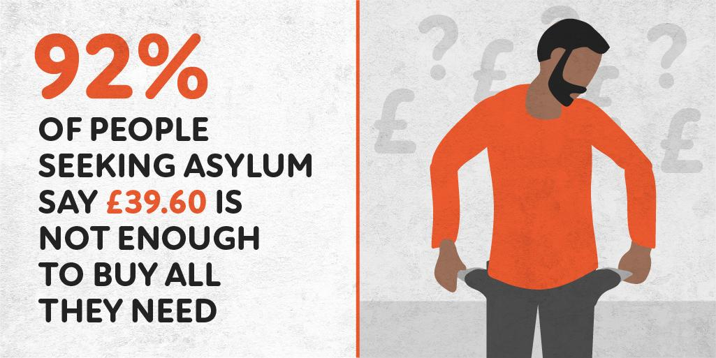
Notes:
The results were clear!

Slide 8
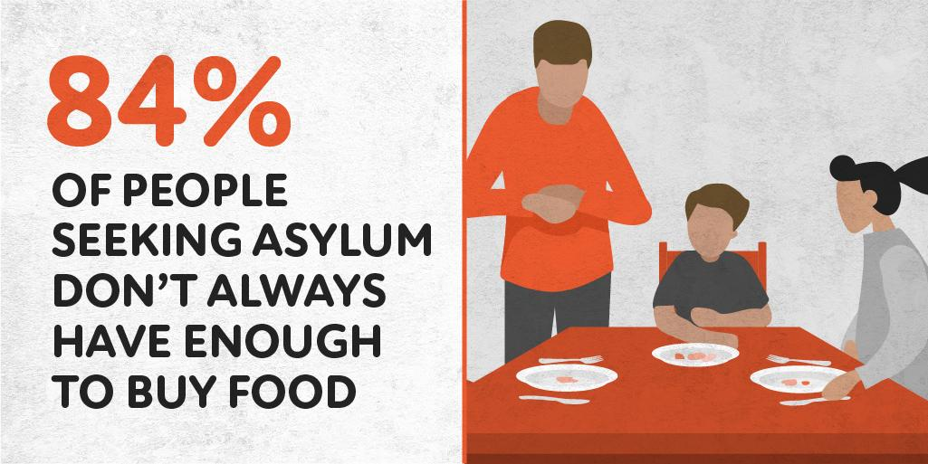

Slide 9
Food: Are you able to buy enough food for yourself/your family?
Insufficient funds
No freezer
Too far to carry food
Too far from cheaper shops
Notes:
People told us they would regularly have to sacrifice other essentials to be able to buy the food they needed.
A combination of factors, such as having insufficient funds, being unable to carry large purchases home from supermarkets, having limited storage and sometimes having no freezer in their asylum accommodation meant families could not make savings through buying in bulk.
Some people also lived further away from cheaper stores, meaning they had to travel long distances by public transport, which was an extra, unaffordable expense.

Slide 10
“Sometimes it's difficult to manage a budget since the cheapest supermarkets are located far away from where I live, and you have to spend more in the local stores.”
“I would like to buy good quality food and these are expensive.
I am not eating healthy because I need to save the money.”

Slide 11
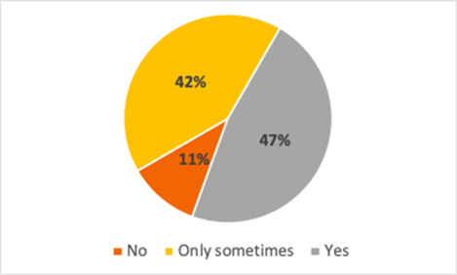
Baby items:Can you buy all the items you need for your baby?
In
Notes:
Mothers commented they sacrificed other items to buy formula, nappies etc

Slide 12
“Because asylum seekers are not given enough money from NASS in order to be able to access the bare minimum.
I would have to substitute food money in order [to buy] anything else and babies are expensive (diapers, baby food etc) and having 3 children myself, I know.”

Slide 13
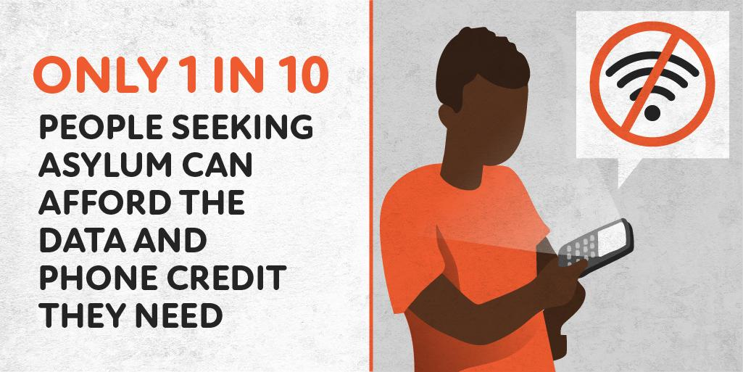
Notes:
As asylum seekers are unable to have bank accounts they can not set up internet provider contract, therefore mobile phones are the only means of accessing wifi
Many people reported usually using free wifi areas as such as libraries, shops and voluntary sector agencies to enable access to the internet - these were not available during lockdown, so people struggles to access services as they went online.

Slide 15
Impact of Covid 19 pandemic
“Not being able to be safe and buy food, groceries, cleaning products etc online [this is due to the fact that asylum seekers aren't allowed bank accounts] for it to be delivered to my house. I have had to risk my life and that of my family who have been at home this entire pandemic as I leave the house weekly in order to get food for my family.”
“I have never been in a difficult situation like this before. People were buying food stuff in bulk but we couldn't. Even a common bag of rice, we can't afford. The coronavirus has really made our lives difficult.”
“It's difficult to stay on a budget and avoid going to the biggest and cheapest shops because local stores are much more expensive.”
Notes:
The ongoing issues of lack of storage and inability to bulk buy was exacerbated by the lockdown.

Slide 16
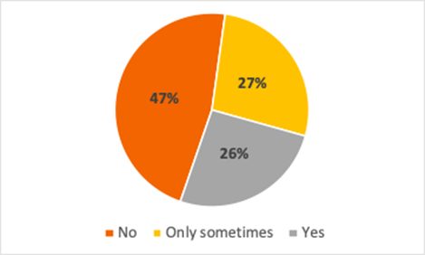
Home schooling: Have you been able to do homeschooling?
Notes:
Most parents reported having difficulty access wifi due to issues raised earlier but also had little or no access to electrical devices such as laptops.
Many referenced the support they received from schools and the voluntary sector as invaluable.

Slide 17
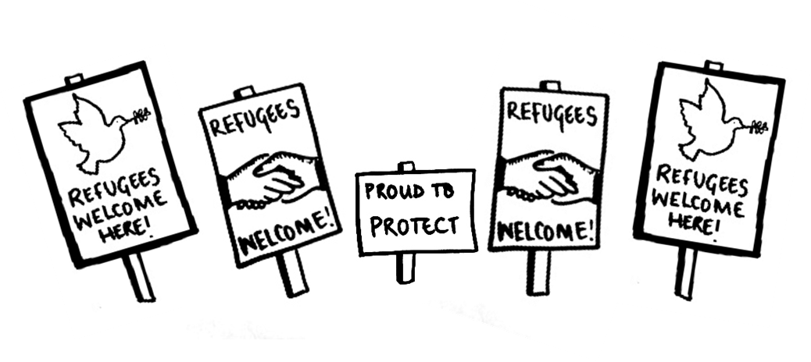
What can we do?
Call on the Home Secretary to reinstate the link with mainstream benefits by setting asylum support at 70% of Universal Credit.
This would ensure people seeking asylum are able to meet their needs both during this pandemic and beyond.
We are also calling on the Home Secretary to lift the ban on working.

