Slide 1
Food & Climate – a Lottery perspective
Food Learning Forum
28 April 2021

Slide 2
Food & Climate Action
TNL Community Fund, and our approach to Environment
Funding Food & Climate Action
Some examples
Trends
Questions
Agenda
Notes:
Challenge = give ‘food for thought’ for participants
Share interconnections between the climate and nature emergency and food

Slide 3
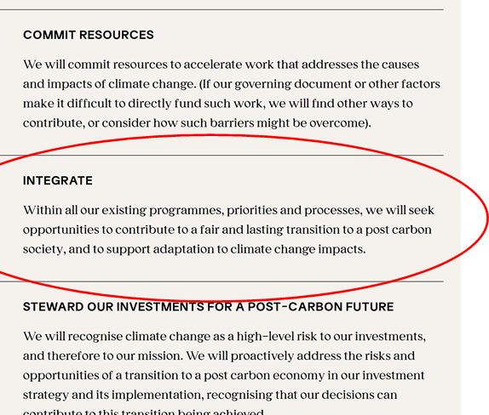
Embedding climate into all our funding

Slide 4
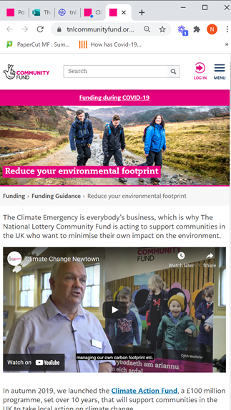
Embedding climate into all our funding
Climate Action Top-ups (Pilot)
Looking at our grant-making practice
Inspire --> Require
Web based information (Envtl Guidance page)
Training
Helping groups to help their customers
Dref Werdd Film
Partnership approach
Regular discussion with other funders
Principle of generous Leadership
Learning out loud
Notes:
Climate Action Top-ups (Pilot)
Expert advice practical support
Looking at our grant making practice: we’ll be developing ways we support current and future grant holders and the wider sector, to consider the climate impact of their work beyond just those directly working on environmental projects.
Colleague engagement
Climate Hub
Review forms, processes, etc.
•Direct grant holders and applicants to the Environmental Guidance page on our website

Slide 5
The role of Food
Food to Engage
Food for Health
Food for Planet
Types of Food people are eating
Reducing Food Miles
Reducing Food Waste
Climate Action Fund sub-themes:
Food Growing
Community orchards, allotments, community gardens
Food Processes
Distribution; Supply chain (local), community food co-operatives, eating habits & diet education
Food Waste
Notes:
We supported Alexandra Rose Charity to expand their fruit & vegetable scheme, which enabled them to test the model outside of London
they have had a good level of success with this. Our funding helped them build their evidence base, which has helped them secure further funding.
Holistic view
Engagement is key. Selling points are key.
Co-benefits = key

Slide 6
Action for Local Food, Islington
Project lead: Octopus Community Network / Global Generation
Aim: address climate change and biodiversity loss through the development of a sustainable local food policy for LB Islington. ​
Three broad strands: climate action ambassadors; food and waste diagnosis; test-and-learn activities across five demonstrator sites. ​
Encourage local eating/shopping, minimise food waste, promote rainwater harvesting, improve understanding of environmental impacts of food.​
Will generate an evidence base that will support local food policy. ​
Notes:
Partnership with Islington Council.​
Three broad strands: outreach, recruitment and training of climate action ambassadors; a borough-wide food and waste diagnosis exercise; and test-and-learn activities across five demonstrator sites.
Progress to date:​
The project has recruited climate ambassadors.​
Plant nurseries and the story garden have stayed open throughout the pandemic but it has been challenge to deliver some parts of the development work as face to face contact with harder to reach groups is a key part of the work. ​
The local impact of COVID-19 has strengthened the council’s support for Octopus and GG as, it has highlighted the need for Islington to increase and maximise its public green spaces and growing spaces.

Slide 7
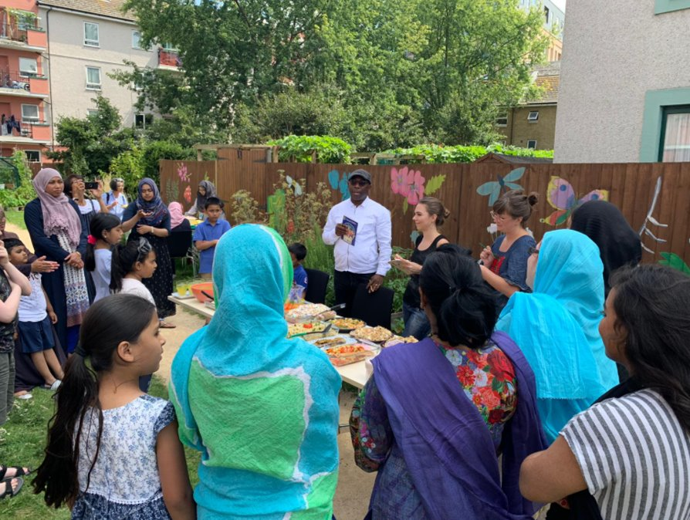
Just Food & Climate Transition, Tower Hamlets
Project lead: Women’s Environmental Network
Aim: to build a sustainable food system that delivers environmental benefits and improve social conditions for Tower Hamlets residents.​
The project will create a community-led blueprint for grassroots food and environmental work that can be shared with other boroughs and cities.​
Aim to build a movement that will push for significant investment in public health, food and sustainability in Tower Hamlets beyond grant period.​
Three community hubs and ten community labs will be at the heart of the project. ​
Notes:
Aim: Partnership with London Leap and a range of local community food projects to build a sustainable food system that delivers environmental benefits and improve social conditions for Tower Hamlets residents.​
Hubs are located in three housing estates chosen to ensure specific local perspectives are included. Each hub will deliver a programme of activities co-designed with residents and will test the ideas from the blueprint.
Progress to date:​
Partners have delivered Theory of Change and Evaluation & Learning Workshops

Slide 8
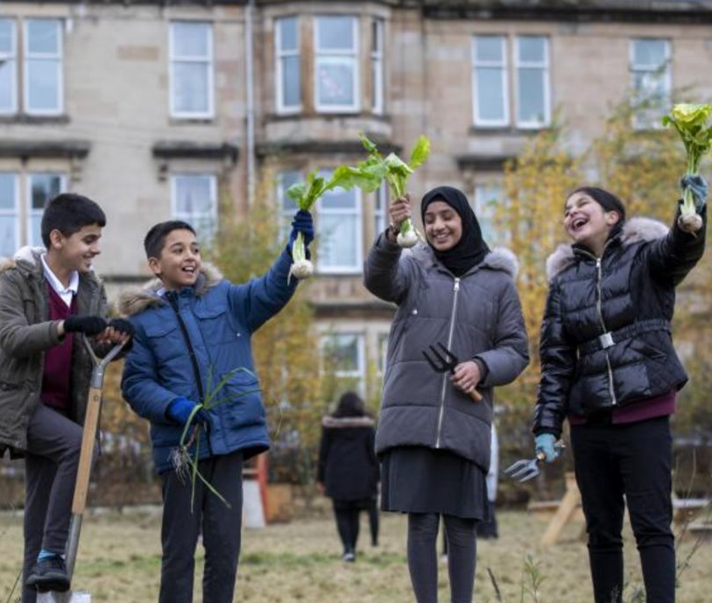
Low Carbon Sustainable Food City for All, Glasgow
Low Carbon Sustainable Food City for All, Glasgow
Project lead: Glasgow Community Food Network
Aim: to make high-quality, healthy and affordable food available to everyone living in Glasgow. ​
Will take a dynamic and asset-based approach to tackling the physical impact of climate change and reducing carbon emissions linked to food production and processes, as well the associated negative impacts on biodiversity, water, soil and air pollution. ​
Communities are empowered to take the lead on the development of initiatives and businesses to further food systems change and together with a comprehensive awareness-raising programme this will sow the seeds of long-lasting behaviour change. ​
Notes:
Glasgow City Food Network (GCFN) are leading a two year development project with a partnership of food community organisations.​
Buy-in from key strategic stakeholders working towards the same goals e.g. Glasgow Centre for Population Health, Glasgow Food Policy and Partnership, Glasgow City Council Food Growing and Planning

Slide 9
Acorn Farm Project, Derry-Londonderry
Project Lead: The Community Foundation for N. Ireland
Aim: to bring the community of Derry-Londonderry together by upskilling local people in food growing and using research to work towards building more resilient local food systems. ​
Builds on existing work in the city, with the long-term vision of creating “Acorn Farm”: a food growing and climate action hub with a geodesic dome as a centrepiece. ​
Due to the Northern Ireland conflict, climate change has not had the same level of engagement as other parts of the UK. This project seeks to influence and address this and it will demonstrate the importance of bringing people together over a common theme in building resilience.
Notes:
Working in in partnership with Derry City & Strabane Council, The Conservation Volunteers, and University College Cork. ​
Progress to date: ​
The number of families in the growing at home (I Can Grow) programme is now 260 against an original target of 100.​
Equipment provided and some expert mentoring from Council’s newly appointed horticulturalist and a team of conservation volunteers, that will run over two growing seasons
The project has attracted donations of organic, peat-free compost from an organics recycling firm and been featured on BBC Radio Ulster. ​
Currently developing the research element of the project and shaping the baseline study, planning a best practice study trip.​

Slide 10
Zero Carbon Cumbria
Project Lead: Cumbria Action for Sustainability
Aim: to build a network of partners to deliver a zero-carbon Cumbria.​
Engaging with businesses and communities to support them in reducing their food carbon footprint, setting up a Low Carbon Business Food Network, developing a digital Low Carbon Food and Share experience. ​
Testing a new model to increase plant-based food production in Cumbria, reduce food miles, and offset carbon usage through agro-forestry. Farmers are being supported to set up a growing cooperatives and generate income into their businesses.
Notes:
16 delivery strands are focused on people living in balance with their environment, with each project relevant to its community.​
Progress to date:​
The project has asked for farmers interested in using an acre of land to grow fruit or veg and have begun a survey to identify local growers, map out potential training, skills sharing opportunities and a machinery tool ring. ​
Match funding has been secured for 10,000 trees from The Woodland Trust to use in agro-foresty. Fruit trees will be grown on land where sheep can graze and other crops like mistletoe can also be grown on the trees.​

Slide 11
Farm Net Zero, Cornwall
Project Lead: Duchy College Cornwall Local Food
Aim: to create opportunities for farmers in Cornwall and beyond to learn about practical and economically beneficial changes they can make to farming practice in order to help the broader farming community move towards net zero sustainably. ​
The project is addressing the contributions agriculture makes the UK’s overall carbon footprint through scaling up a blend of local demonstrator farms targeting soil health, peer to peer learning on effective action, and opportunities to share knowledge and strengthen support networks of farmers and their surrounding communities. ​
Wider community aims include citizen science projects to engage local people in replicating ways to improve soil health at the micro level. ​
Notes:
Media training for farmers will help them develop confidence and skills needed to engage in wider climate discussions and share learning more effectively. ​

Slide 12
Trends
Impact of Covid!
Scaling up education of communities, food distribution and repurposing
Studies to understand what is in their communities in terms of food waste
Composting at home, or hubs/sites
Behaviour change – education projects
General rise in communities becoming aware of disused spaces and coming together to make something useful from the space
Scaling of ‘pay as you feel’ cafes and community fridges. Also food banks.
Notes:
Disused spaces: (usually with a growing element) this is perhaps also been encouraged by our year of staying at home, micro-local daily walks, passing the same unused spaces multiple times a week etc.
Then, it’s a depressing trend but the rise of food-banks is not a healthy food system sign, and how is that likely to develop in the short and long term.

Slide 13
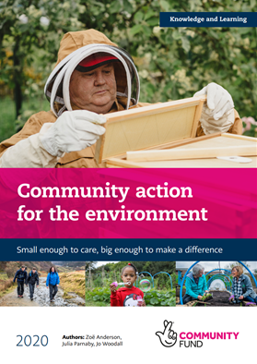
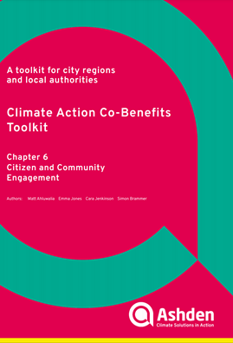
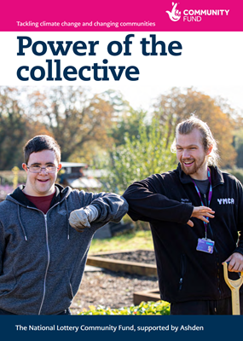
Publications
Notes:
https://www.tnlcommunityfund.org.uk/media/documents/KL20-02-Community-Action-for-the-Environment.pdf?mtime=20200917131603&focal=none
https://ashden.org/wp-content/uploads/2020/09/CAC-TOOLKIT-CHAPTER-6.pdf
https://www.tnlcommunityfund.org.uk/media/insights/documents/CAF-Power-of-the-collective.pdf?mtime=20210224094157&focal=none

Slide 14
Questions
What does sustainable food look like in practice?
What are the key challenges?
Who should community-focused projects be targeting?
(e.g. wealthier segment tend to have higher carbon footprint)
In designing a programme, are we asking the right questions?
(i.e. not just a focus on quick wins, but what will make the long-term impact?)
What does an understanding of psychology give us?
(e.g. social cohesion correlates with pro-environmental behaviours, so should we invest in this?)
How much should we ‘dance with the devil’?
(i.e. big corporates in food space)
Where is resistance coming from in the system?

Slide 15
Thank you
nick.gardner@tnlcommunityfund.org.uk
@cannyfrog
#ClimateFundUK

