Slide 1
Theory of Change Workshop
Livia La Camera, Head of Health, GCDA
Mel Taylor, Head of Learning, GCDA

Slide 2
What is theory of change?

Slide 3
Videos
https://www.youtube.com/watch?v=cg4J1g0IVHg
https://www.youtube.com/watch?v=BJDN0cpxJv4

Slide 4
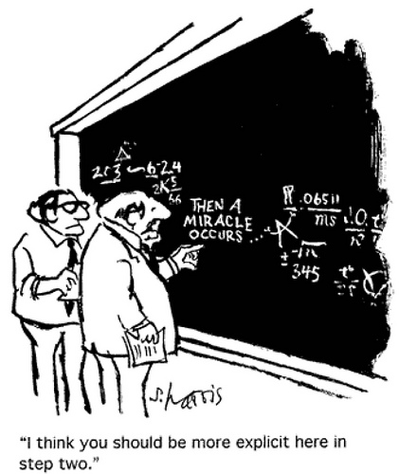
TOC definitions
Theory of Change is essentially a comprehensive description and illustration of how and why a desired change is expected to happen in a particular context.
It is focused in particular on mapping out or “filling in” what has been described as the “missing middle” between what a program or change initiative does (its activities or interventions) and how these lead to desired goals being achieved.
It does this by first identifying the problem, and the desired long-term goals and then works back from these to identify all the conditions (outcomes) that must be in place (and how these related to one another causally) for the goals to occur.
These are all mapped out in an Outcomes Framework.

Slide 5
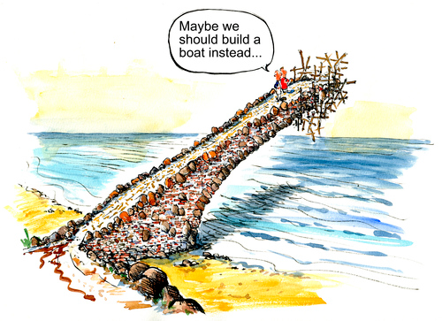
The Outcomes Framework then provides the basis for identifying what type of activity or intervention will lead to the outcomes identified as preconditions for achieving the long-term goal.
Through this approach the precise link between activities and the achievement of the long-term goals are more fully understood.
This leads to better planning, in that activities are linked to a detailed understanding of how change actually happens.
It also leads to better evaluation, as it is possible to measure progress towards the achievement of longer-term goals that goes beyond the identification of program outputs.
https://www.theoryofchange.org/what-is-theory-of-change/

Slide 6
Why do you think this could be a helpful approach?

Slide 7
This could be used for?
Internal project development – helps refine and enhance the effectiveness of your project
External communication – to tell people what your project/organisation does, and how it has an impact in a clear and convincing way
Evaluation – it’s the first step in designing effective evaluation tools as it identifies all your outcomes that need to be measured
To help develop a new project
Distinguishing the income generation outcome from the social outputs of a social enterprise
Understanding the steps that are missing
Explain and justify why you're doing what you're doing
Tackling a social issue with complex and has multiple causes

Slide 8
How to implement a theory of change
Identify your project aims/ goal – e.g. emergency food aid or tackling poverty
Collect evidence of need and context
Write it in a group to capture input from staff, stakeholders, and even beneficiaries – facilitate the creative process
Agree your intended impact
Identify your outcomes (can be short, medium, and long-term) – how are they measurable?
Identify outputs and activities
Identify causal links – arrows that show which activities lead to which outcomes, and which outcomes lead to which goal
Clarify assumptions – these underpin each causal link
Establish a timeline and plan resources
Produce your framework and narrative for external and internal use
Get ready to use your theory of change

Slide 9
Your turn
What is the problem you want to solve? What evidence do you have or what needs assessment have you done?
What is the long-term impact you want to see – the desired state?
What are the outcomes that will help you achieve a solution to this?
What are the activities you doing to solve it?
What are the outputs you will measure?
Who do you need to involve in the process?
How have you made your assumptions? How do you know the outputs and activities will lead to the outcomes?

Slide 10
PROBLEM | ACTIVITIES | OUTPUTS | OUTCOMES | DESIRED STATE
Many families in areas of high social deprivation lack affordable access to fresh fruit and vegetables, leading to poor diet, poor health and a lack of awareness of the benefit of fruit and veg. | Purchase of fruit & veg through wholesale partners Picking up, sorting and delivering fruit & veg to schools & children centres Tracking orders and monitoring and evaluating project Accept healthy start voucher at stalls Volunteer training Employ 1 person | 15 stalls in Greenwich 10 volunteers trained Collate 10 case studies from each site Reach 2,000 families in first year No. of Healthy start beneficiaries using voucher at stalls No of recipes shared with families Testimonies | Improved health Increased variety of fruit and veg eaten Increased use of Healthy start vouchers to purchase F & V Increased knowledge of how to use fruit and veg i.e. via recipes | More families from the areas of highest social deprivation to have access to a wider variety of fresh affordable F & V and to have more opportunities for families to feed their children healthy food and to be healthier

Slide 11
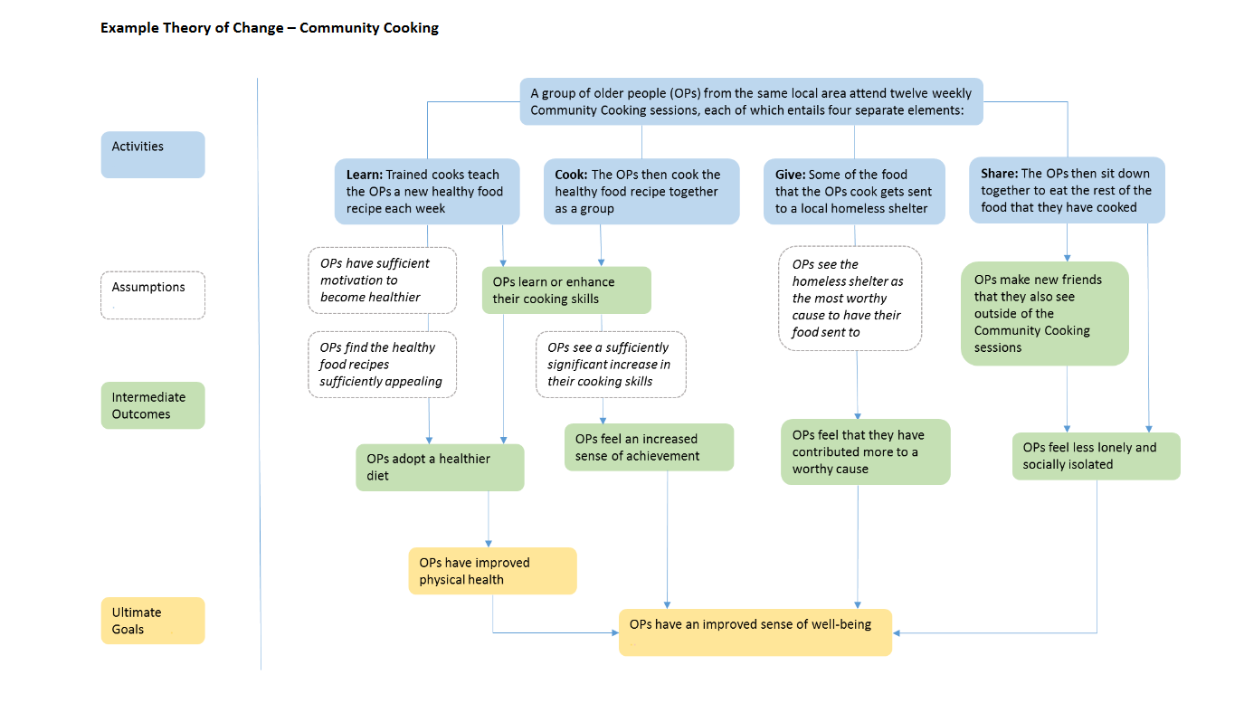

Slide 12
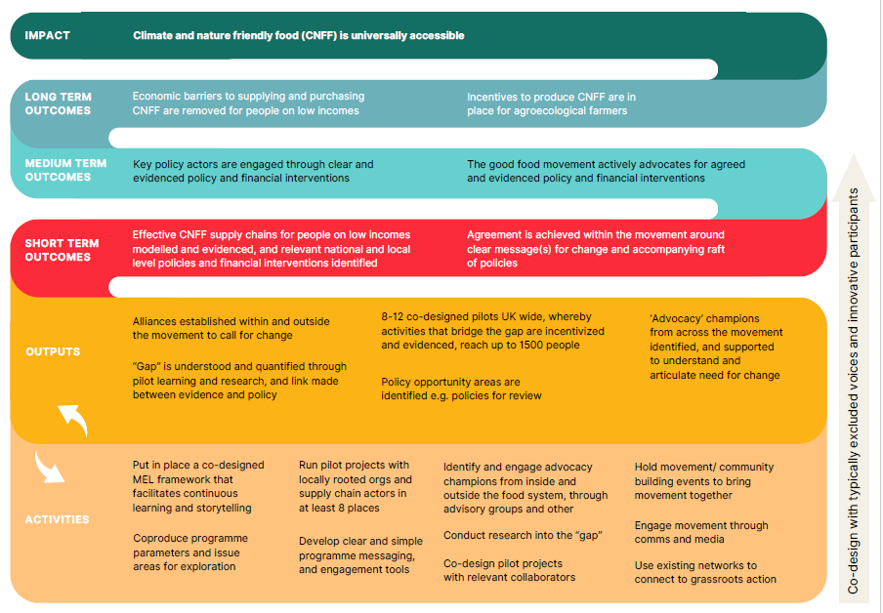
Example – Sustain, Bridging the Gap

Slide 13
Problems
Activities
Outputs
Outcomes
Desired state
Context
Assumptions
Assumptions
Assumptions

Slide 14
Further reading & Examples
https://www.theoryofchange.org/
NCVO Knowhow lots of information
Fareshare
Community Food and Health
The Kindling Trust
Nesta Guidance
Fareshare Theory of Change

