Slide 2
Every mouthful counts: Unlocking a metropolitan food revolution

Slide 3
Our research themes
Governance
Farming and food growing
Food waste
Procurement

Slide 4
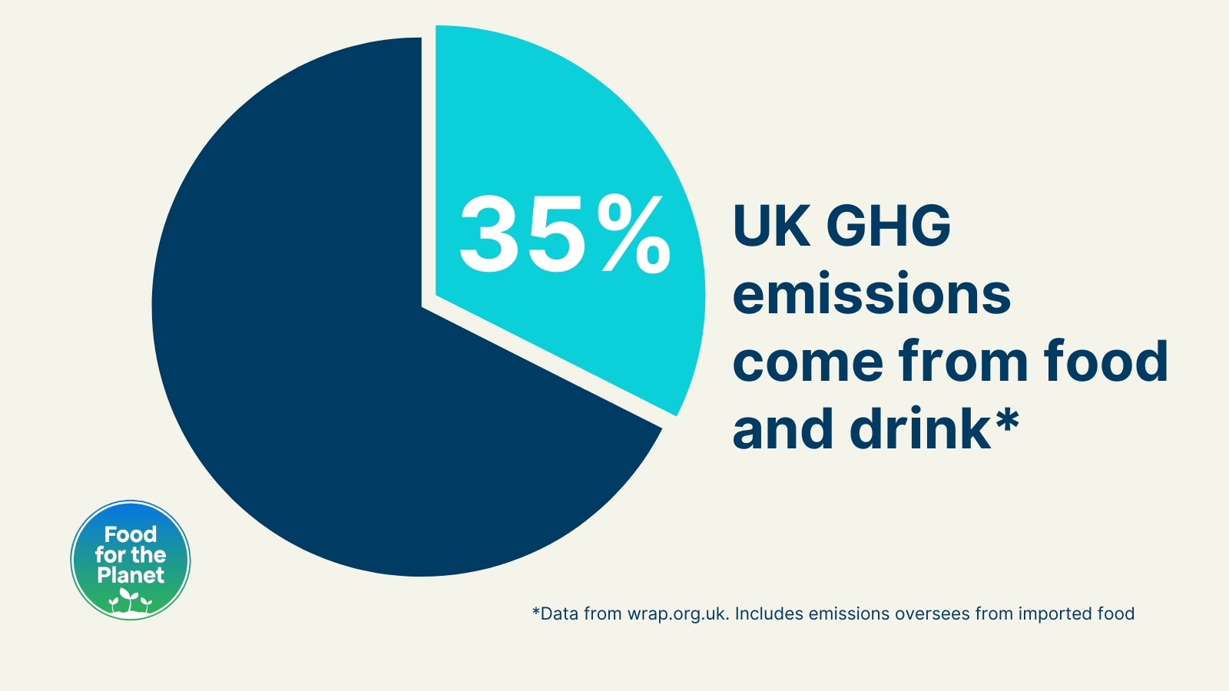
Why did we do this?
Food makes up over 1/3 GHGs and main driver of biodiversity destruction in the UK.
Metropolitan councils wield substantial influence in steering Britain's food system toward a sustainable path
Huge missed opportunity for councils to unlock co-benefits.
Provide a clear and comprehensive roadmap for action.

Slide 5
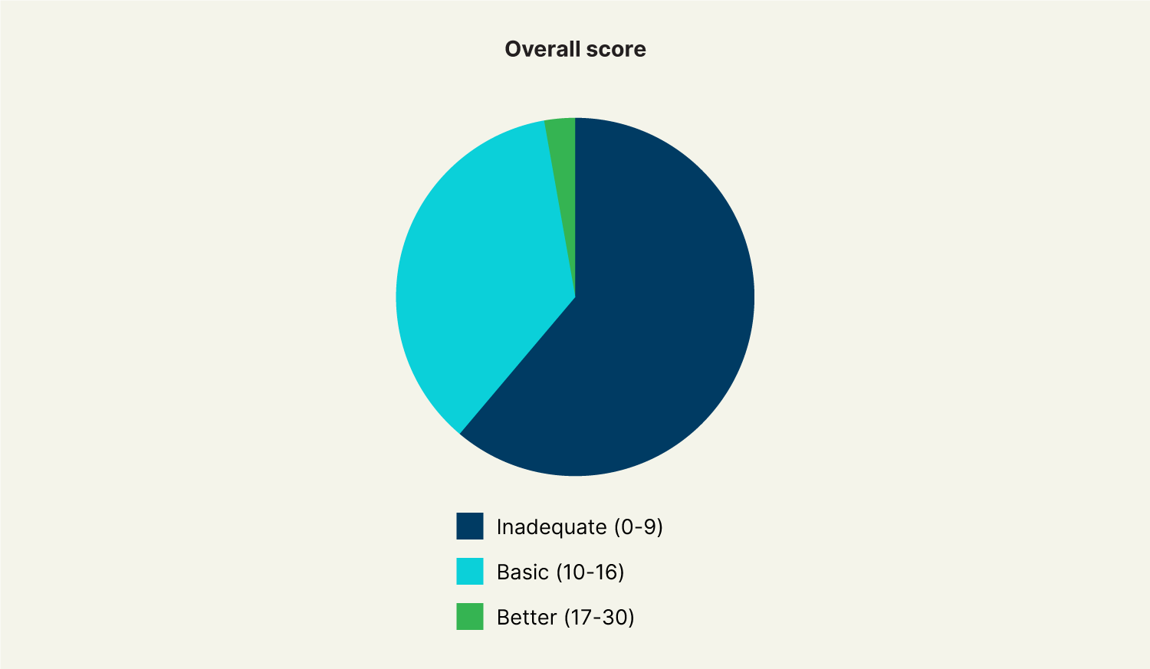
What did we find?
On average, metropolitan councils scored less than one third (31%) of available points
36% had only a ‘basic’ set of policies in place
Six in ten councils are taking no meaningful action
Just 3% have more developed and measurable plans
Councils working with food partnerships scored better

Slide 6
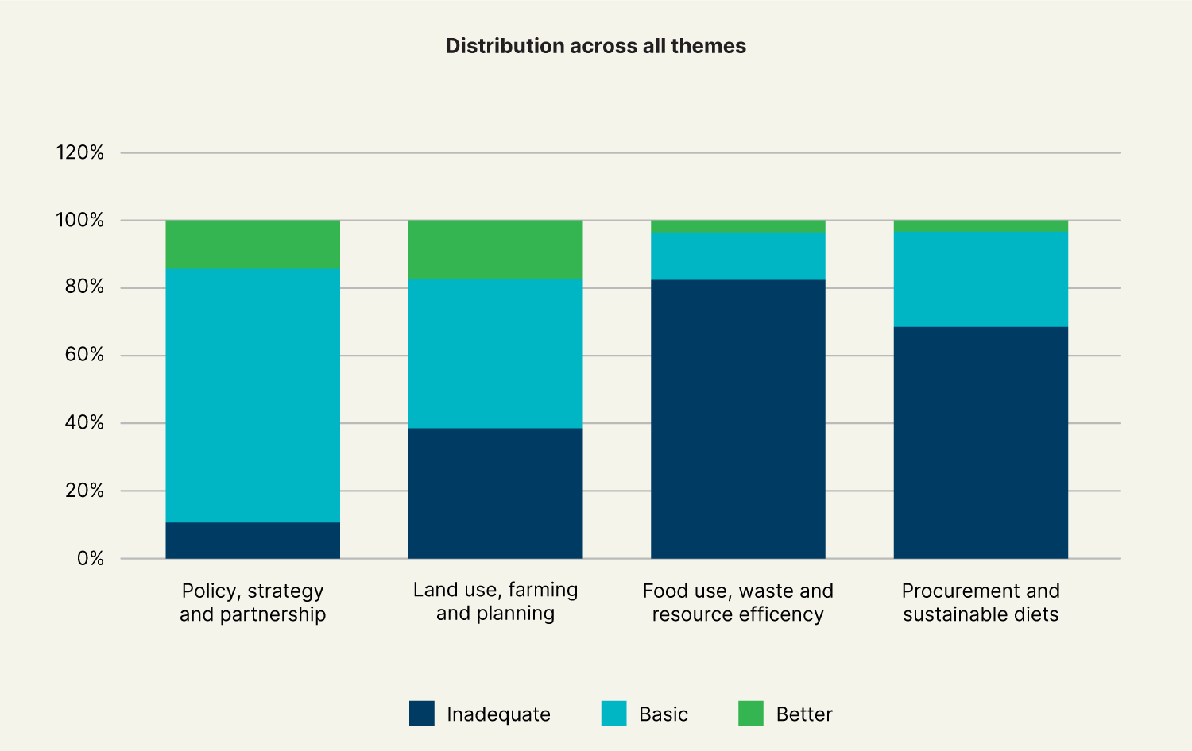
What did we find?
Similar scores to non-metropolitan councils
Performed better on Policy, Strategy and Partnership
National guidance frustrates progress on food waste
Councils excelled in Land Use, Farming and Planning

Slide 7
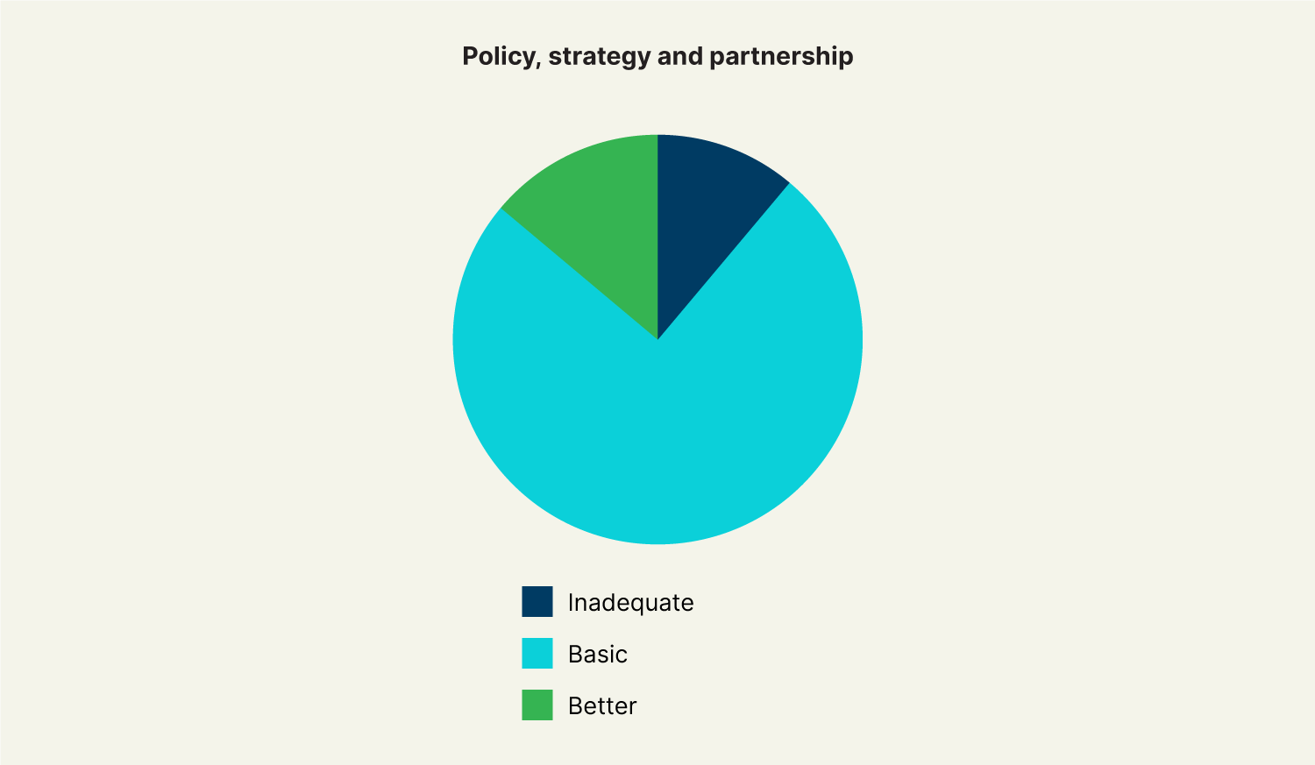
Governance
100% had declared a climate and nature emergency
56% have food partnerships
87% had a climate action plan
But only 15% scored ‘better’ in this area - putting in place governance structures and interventions to deliver on their plan

Slide 8
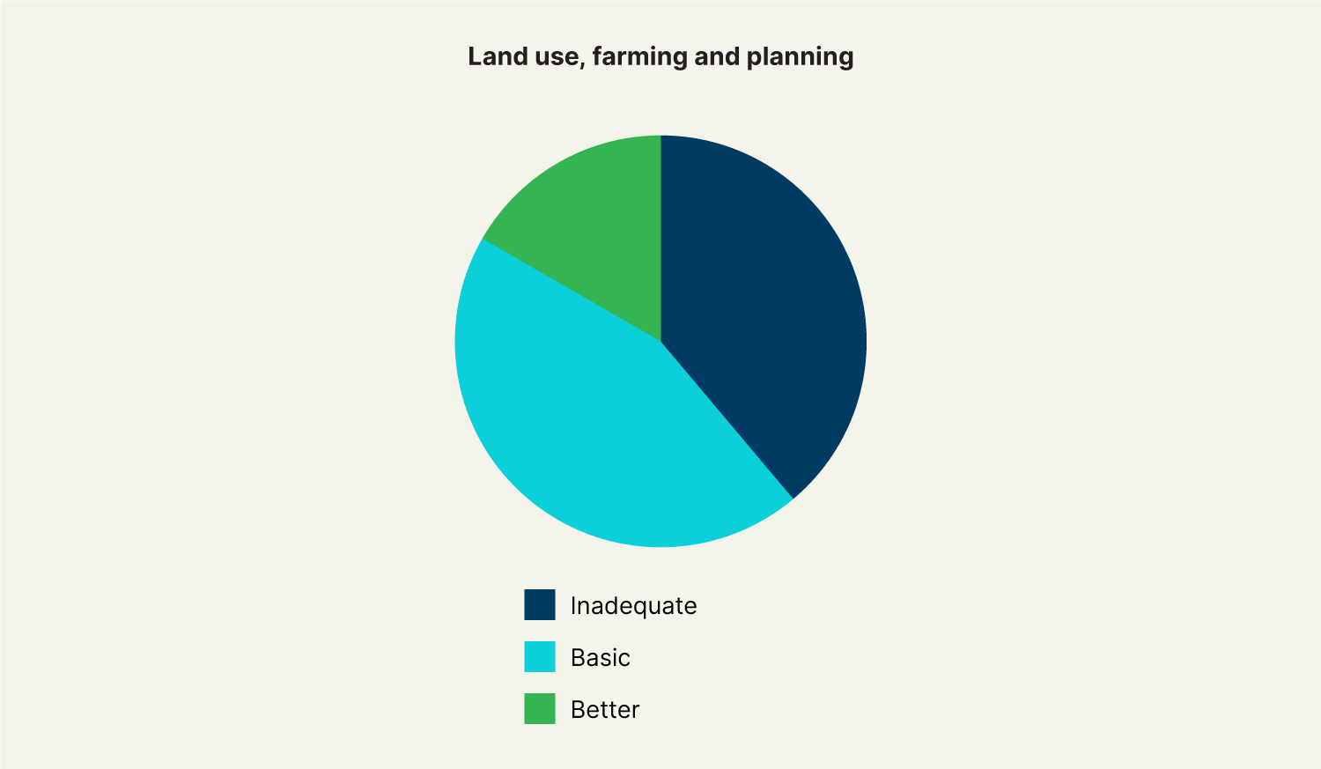
Farming and food growing
Marginally better on land use, farming and planning compared to other council types
Potential in community food growing and allotments
Opportunities to collaborate with rural neighbours and utilise peri-urban and rural land

Slide 9
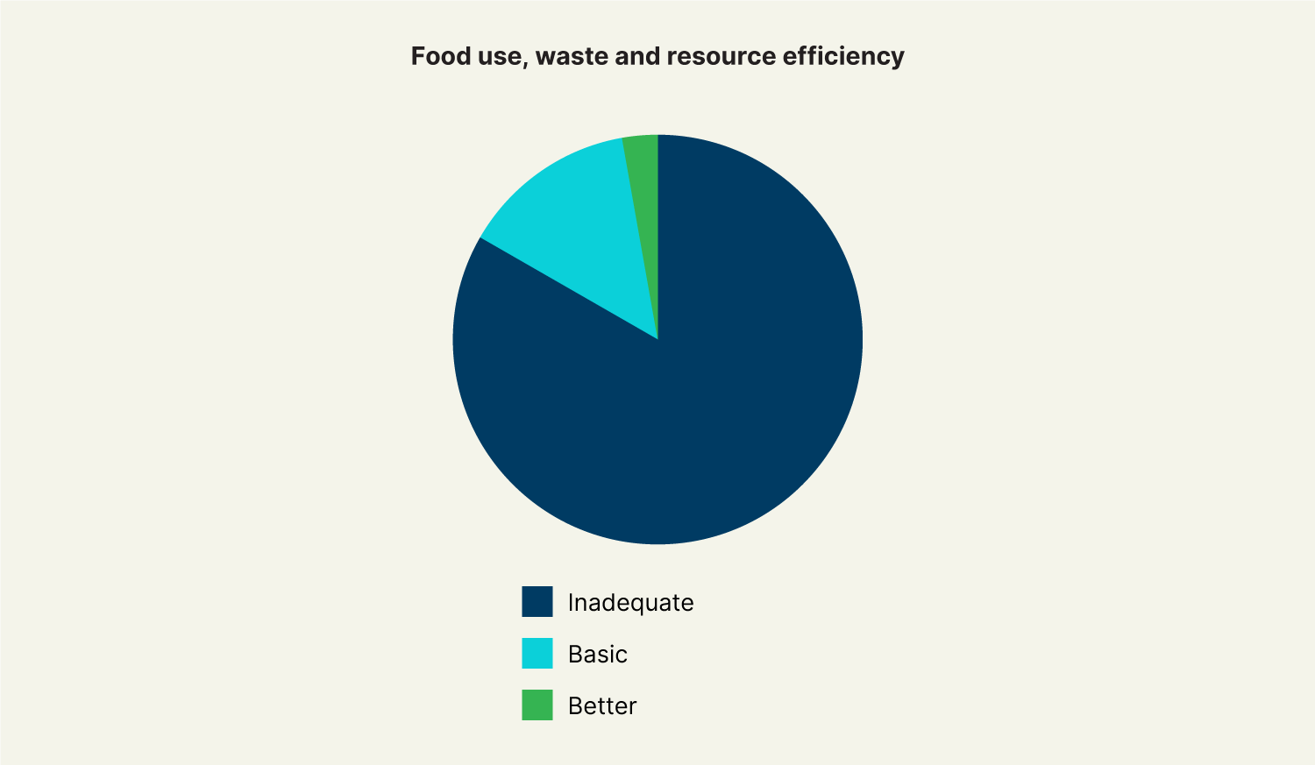
Food waste management
Poor performance in food waste
83% scored inadequately, with only 3% receiving a ‘better’ score
Urgent need for the expansion of food waste collection and scaling up surplus food distribution

Slide 10
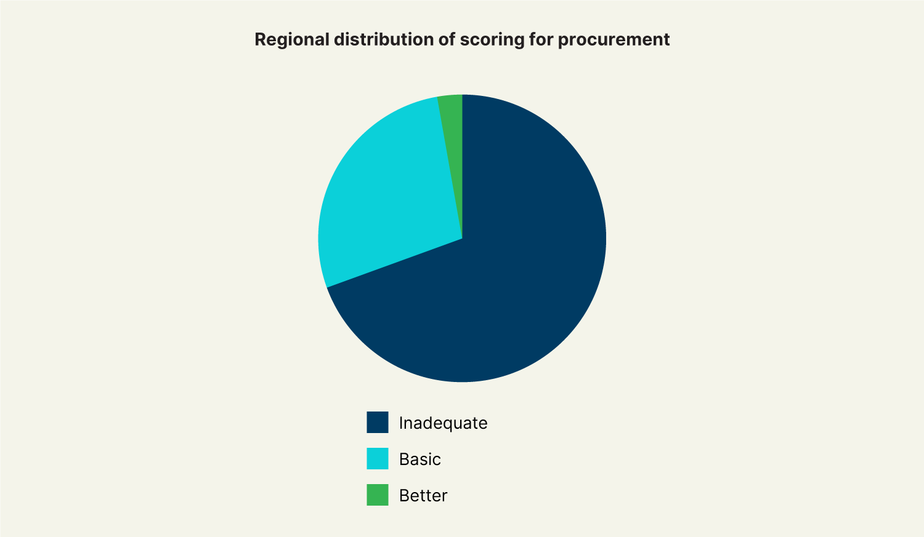
Procurement
Scored marginally better than other council types on procurement and sustainable diets
Procurement is a potentially highly influential lever for change – council spend is over £69 million annually
Metropolitan councils need to be more ambitious

Slide 11
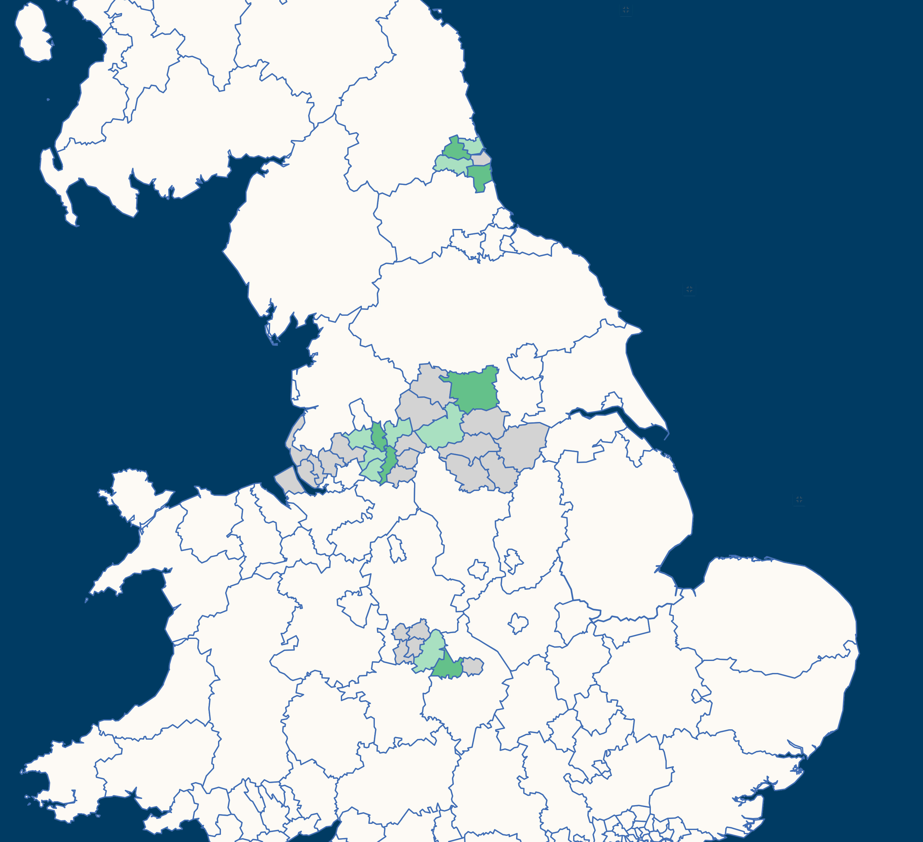
Recommendations from high performing councils
1. Climate emergency and climate action plans are fundamental
2. Establish food partnerships
3. Tie food strategies to existing council priorities
4. Collaboration and co-working is key!

Slide 12
Recommendations from Sustain
Incorporate food plans into climate and nature strategies.
Sign up to the Every mouthful counts toolkit.
Develop a sustainable food procurement policy.

Slide 13
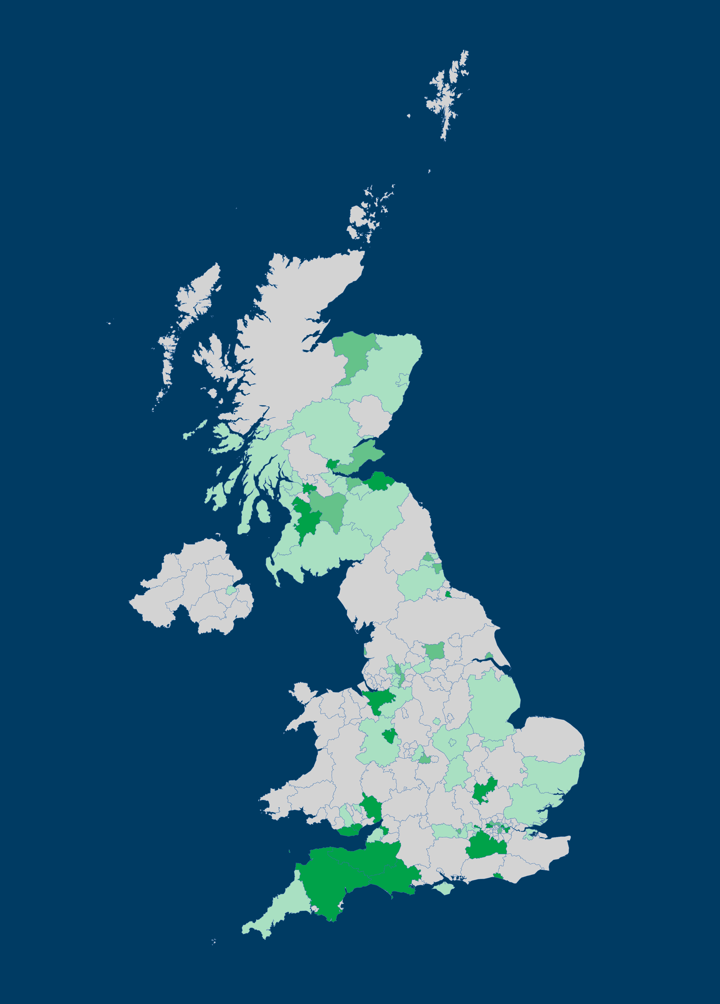
Our national policy asks
Legally-binding buying standards
Remove 3 day a week meat requirement for schools
Support food waste collection services
Reform national planning policies
Provide Local Nature Recovery guidance
Enforce emission reduction targets for businesses

Slide 14
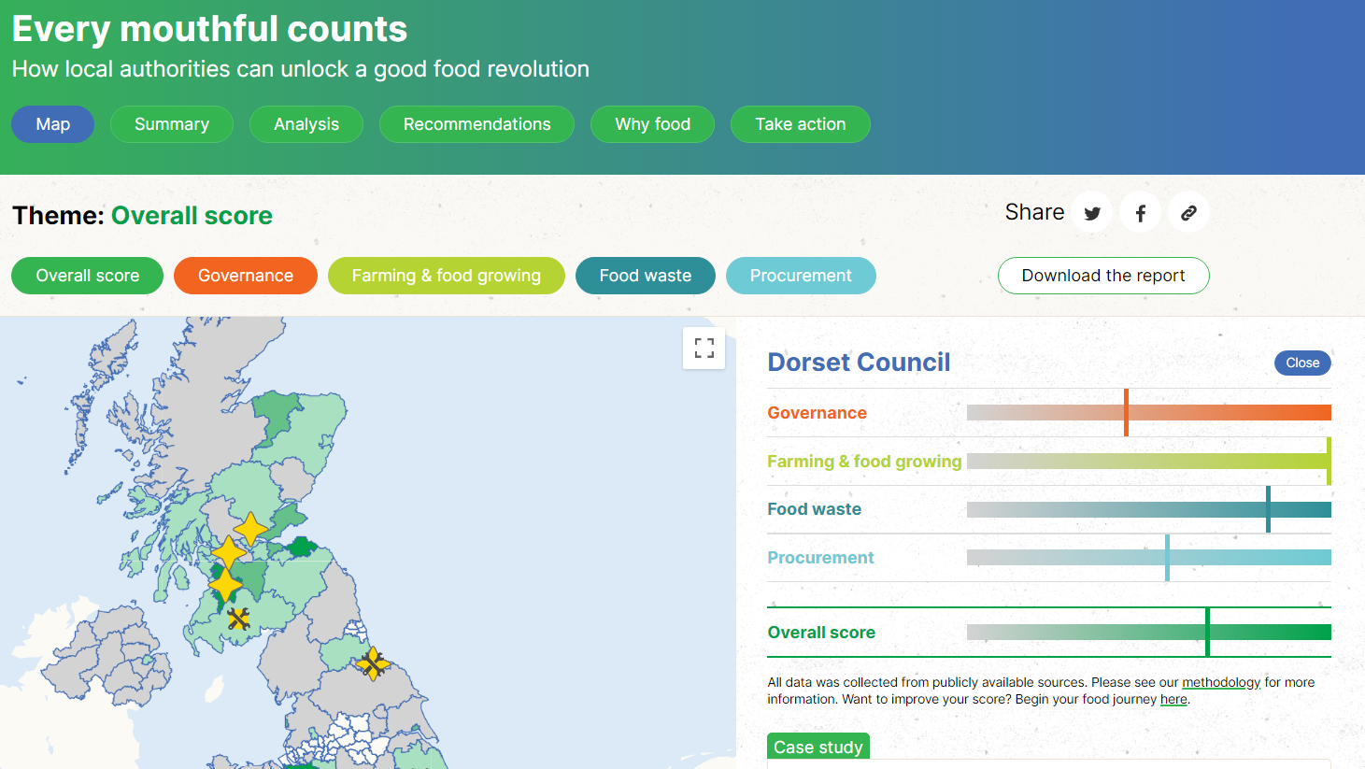
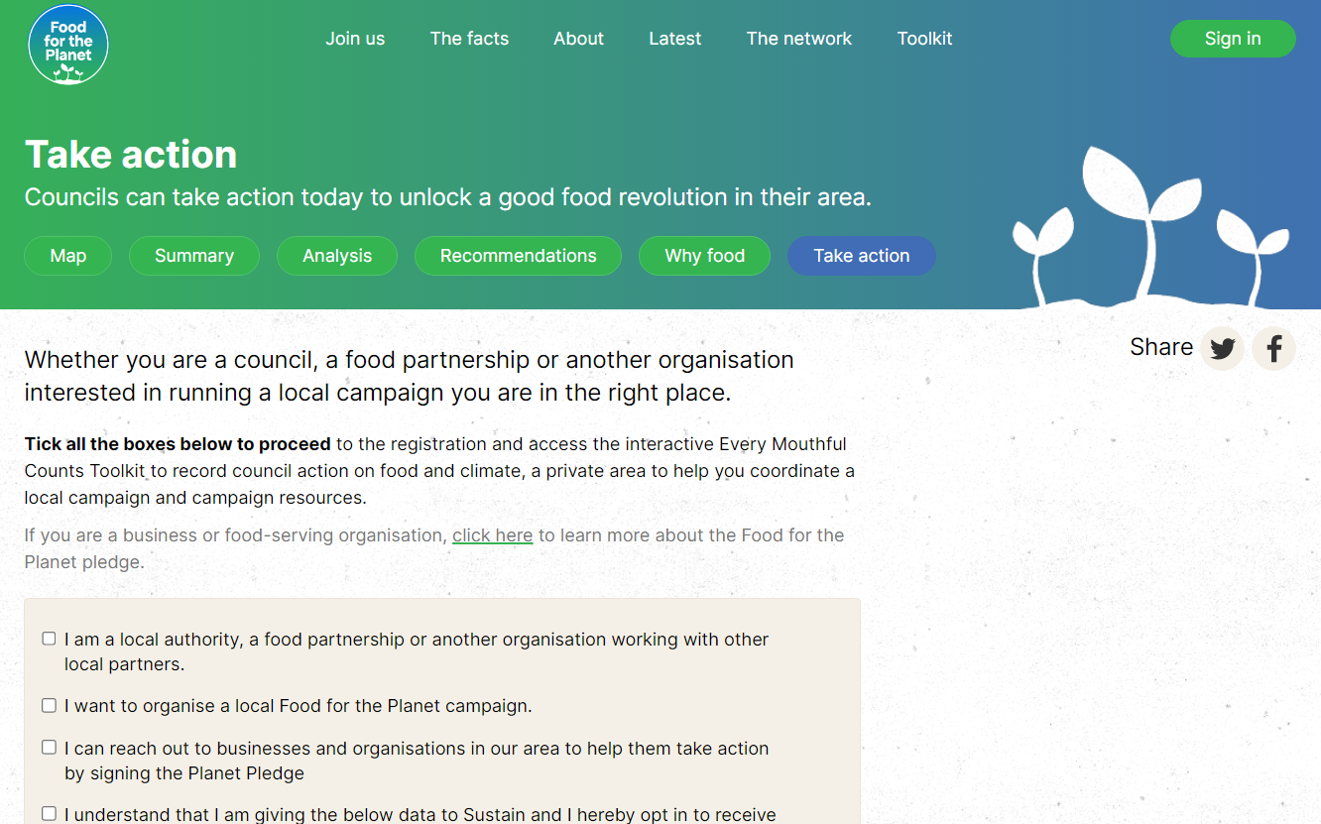
What next?
Sign up to the Every mouthful counts toolkit.
We'd love to help you develop your food strategies.
If you haven't, set up a Sustainable Food Places food partnership.
Reach out for a summary of your results at lily@sustainweb.org

