Slide 1
Every Mouthful Counts
Nick Porter
www.local.gov.uk

Slide 2
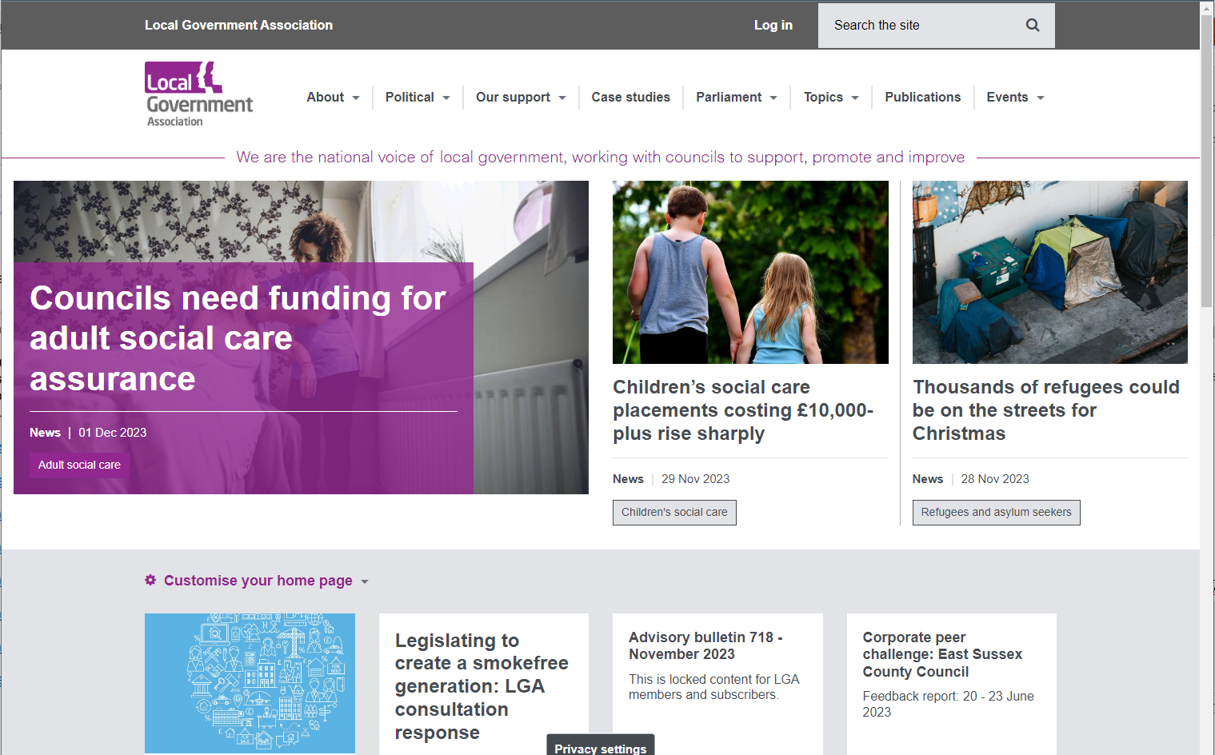

Slide 4
Instructions

Slide 5
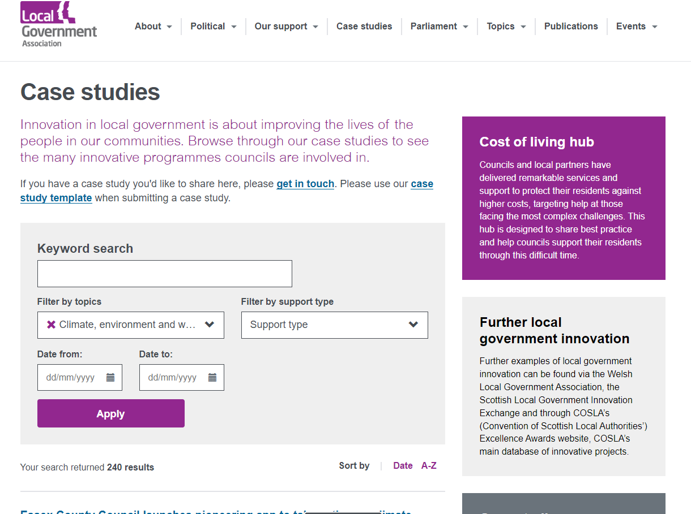

Slide 6
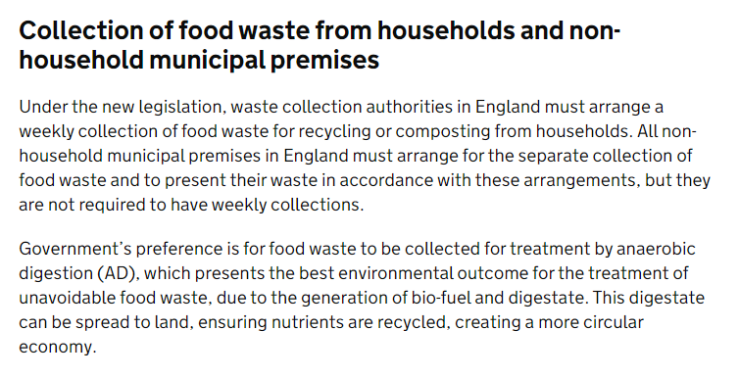
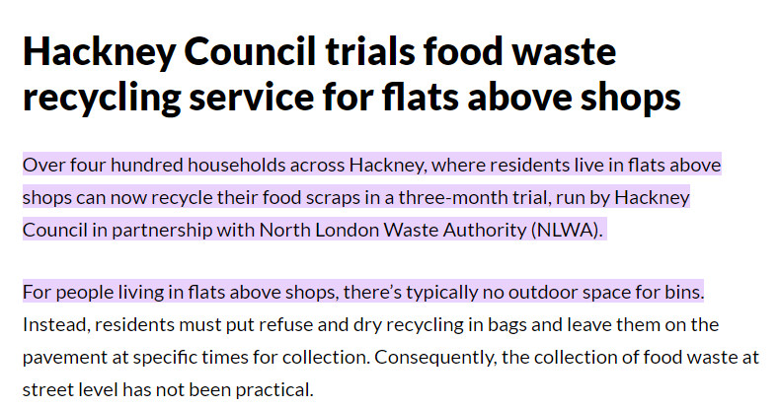

Slide 10
