Slide 1
Every Mouthful Counts – Leeds Food Strategy
December 2023
Andrew.White@Leeds.gov.uk

Slide 2
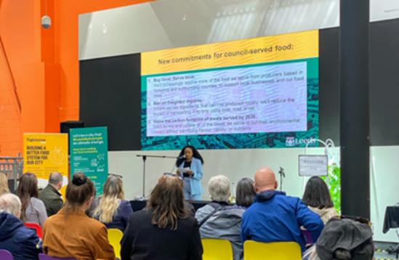
Leeds Food Strategy
Background
Mission 1 – Health & Wellbeing
Mission 2 – Food Security & Economy
Mission 3 – Sustainability & Resilience
Next steps
Q&A

Slide 3
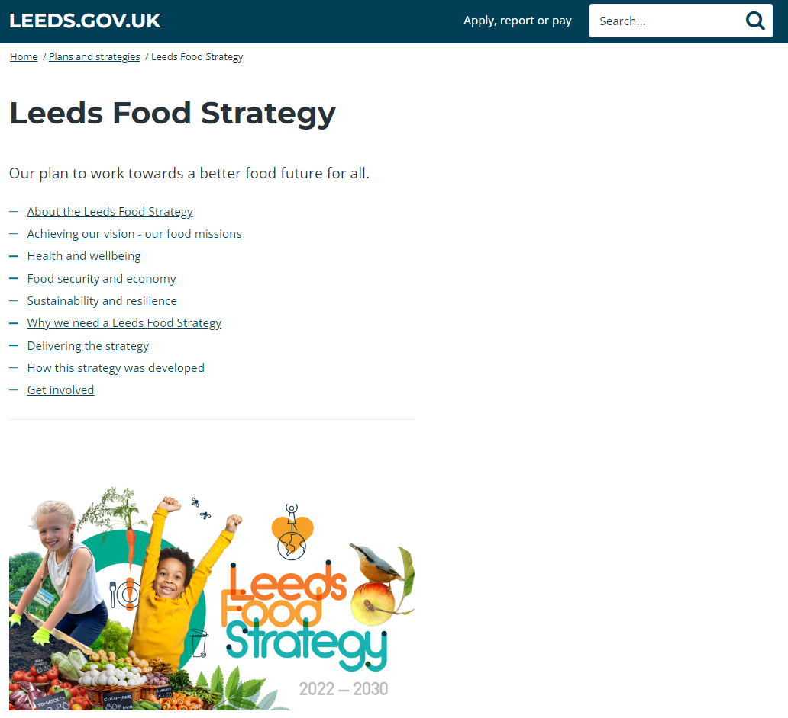
Background
2006-2010: Food Strategy in place
Sep 2014: Feed Leeds deputation to LCC recommending a food strategy for the city – Director of Public health tasked with building the partnership
2017: Leeds Food Partnership established (LCC, Feed Leeds, University of Leeds)
Oct 2022: LCC Executive Board approved plans to consult on draft Leeds Food Strategy
Oct-Dec 2022: Consultation on draft Leeds Food Strategy
Mar 2023: LCC Executive Board approves Leeds Food Strategy
Jul 2023: Leeds Food Strategy launched https://www.leeds.gov.uk/plans-and-strategies/leeds-food-strategy – aim is for it to run to 2030
Notes:
This slide summarises the main points of the report to CEAC

Slide 4
Background
Leeds Food Strategy a partnership of FoodWise Leeds and Leeds City Council (Public Health, Financial Inclusion, Climate, Energy & Green Spaces)
Leeds Food Strategy has three missions, align closely with three council pillars.
Mission 1: Our mission is to improve the health and wellbeing of everyone in our city through eating well.
Mission 2: Our mission is to ensure we can all access affordable, nutritious food as part of a diverse, inclusive, and vibrant food economy.
Mission 3: Our mission is to ensure the way Leeds produces, consumes, and disposes of food is fit for the future and supports our climate action plan.
Notes:
This slide summarises the main points of the report to CEAC

Slide 5
Mission 1: Health and Wellbeing
Objective 1
Ensure people of all ages know how to access, prepare, and eat food that supports health and wellbeing.
Objective 2
Champion community food initiatives that support healthier eating.
Objective 3
Change our city environment to help make healthier food more available and appealing.
Objective 4
Offer targeted support to those of us who are most at risk.
Objective 5
Develop a skilled local workforce who advocate for healthier eating.
Notes:
Mission 1 and 5 objectives led by LCC Public Health and FoodWise Leeds – Appendix A of the report details the action plan

Slide 6
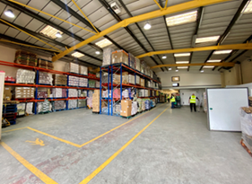
Mission 2: Food security and economy
Objective 1
Tackle factors limiting people’s ability to afford the food they need.
Objective 2
Help those in need of support to access affordable and inclusive food initiatives.
Objective 3
Continue to build a strong partnership approach across all sectors and with the people of Leeds.
Objective 4
Support and unlock opportunities for local food businesses and workers.
Objective 5
Promote Leeds as a vibrant food city—celebrating our independent food, drink, events, and culture.
Notes:
Mission 2 and 5 objectives led by LCC Financial Inclusion and FoodWise Leeds – Appendix B of the report

Slide 7
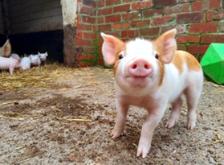
Mission 3: Sustainability and resilience
Objective 1
Tackle waste by reducing, redistributing, and utilising surplus food.
Objective 2
Raise awareness of how we can eat nutritious foods that are good for the planet.
Objective 3
Encourage and embrace new ways of producing, selling and serving food within local communities.
Objective 4
Support local farmers to transition to resilient and profitable agriculture which improves the environment.
Objective 5
Champion environmentally sustainable and resilient food buying.
Notes:
Mission 3 and 5 objectives led by Climate Energy & Green Spaces – Appendix C of the report

Slide 8
Next steps
Leeds Food Strategy has 42 action points supporting the 3 missions and 15 objectives
FoodWise Leeds – quarterly meetings
LFS Steering group – twice annually
LCC internal group – three times a year
Report on progress to LCC Executive Board spring 2024

Slide 9
Any Questions?
Notes:
Answer questions if possible, written reply if not possible

